Slide 1

Use Case Diagram

Slide 2
Introduction
Use-cases are descriptions of the functionality of a system from a user perspective.
  Depict the behaviour of the system, as it appears to an outside user.
  Describe the functionality and users (actors) of the system.
  Show the relationships between the actors that use the system, the use cases (functionality) they use, and the relationship between different use cases.
  Document the scope of the system.
  Illustrate the developer’s understanding of the user’s requirements.

Slide 3
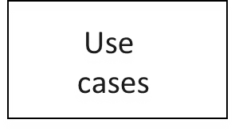
Purpose of Use Case Diagram
Class
diagrams
Activity
diagrams
Requirements
document
(text in natural language)
Sequence
diagrams
Statechart
diagrams
Use case modelling is an iterative and incremental process.
  If user requirements change, the changes should be made in all the affected documents.

Slide 4
Use Case diagrams, basic UML notation
Use Case: A Use Case is a description of a set of interactions between a user and the system.
Components of use case diagram:
  Actor
  Use case
  System boundary
  Relationship
use case name
use case name
use case name

Slide 5
ACTOR
An actor is some one or something that must interact with the system under development.
Actors can be human or automated systems.
Actors are not part of the system.
UML notation for actor is stickman, shown below.
Student
Faculty
Employee

Slide 6
ACTOR (contd..)
It is role, a user plays with respect to system.
Based on the similar interaction, the actors can be grouped.
Actors carry out use cases and a single actor may perform more than one use cases.
Actors are determined by observing the direct users of the system.

Slide 7
Primary and Secondary Actors
Primary Actor
  Acts on the system.
  Initiates an interaction with the system.
  Uses the system to fulfill his/her goal.
  Events Something we don’t have control over.
Secondary Actor
  Is acted on/invoked/used by the system.
  Helps the system to fulfills its goal.
  Something the system uses to get its job done.

Slide 8
USE CASE
A use case is a pattern of behavior, the system exhibits.
Define coherent piece of functionality without revealing the internal structure of the system.
The use cases are set of actions that the user takes on a system to get particular target.
USE CASE is dialogue between an actor and the system.
Examples:
Add a course
Buy a beverage

Slide 9
USE CASE
A use case typically represents a major piece of functionality that is complete from beginning to end.
Most of the use cases are generated in initial phase, but may add some more after proceeding.
A use case may be small or large.
Captures a broad view of a primary functionality of the system in a manner that can be easily grasped by non technical user.

Slide 10
USE CASE: Example
For a vending machine:
  Buy a beverage
  Perform scheduled maintenance
  Make repair
  Load items

Slide 11
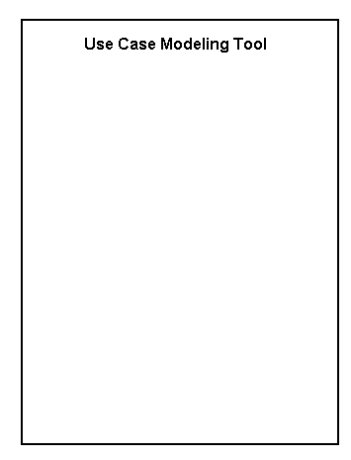
System Boundary
It is shown as a rectangle.
It helps to identify what is external versus internal, and what the responsibilities of the system are.
The external environment is represented only by actors.

Slide 12
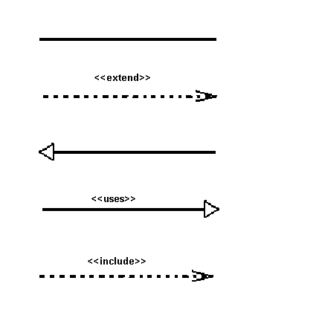

Relationship
Relationship is an association between use case and actor.
There are several Use Case relationships:
Association
Extend
Generalization
Include

Slide 13
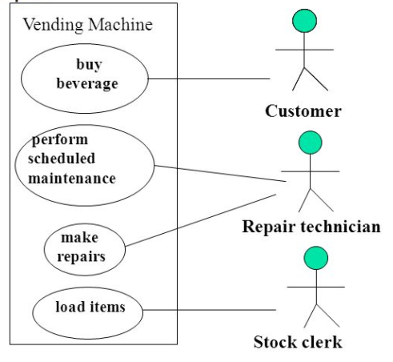


Slide 14
Extend Relationship
The extended relationship is used to indicate that use case completely consists of the behavior of another use case at one or specific point.
The base use case implicitly incorporates the behavior of another use case at certain points called extension points.
It is shown as a dotted line with an arrow point and labeled <<extend>>.
Login
<< extend>>
Register New User

Slide 15
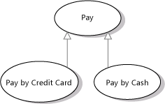
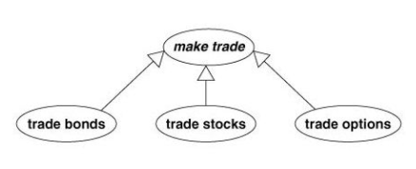
Generalization
Generalization is a relationship between a general use case and a more specific use case that inherits features of it.
Use cases that are specialized versions of other use cases.
It is shown as a solid line with a hollow arrow point.

Slide 16

Include Relationship
The insertion of additional behavior into a base use case that explicitly describes the insertion.
The base use case explicitly incorporates the behavior of another use case at a location specified in the base.
They are shown as a dotted line with an open arrow and the key word <<include>>.

Slide 17
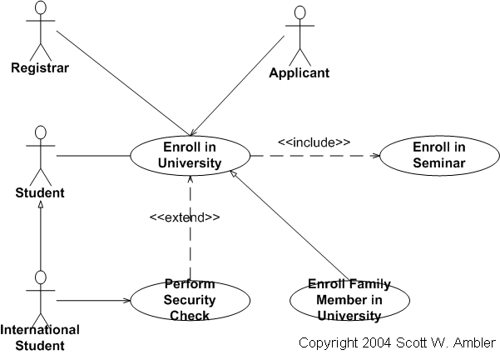
Extend vs Include

Slide 18
Guidelines for Use case models
Determine the system boundary
Ensure that actors are focused: Each actor should have a single coherent purpose.
Use case must provide value to the user: Focus on purpose of functionality provided by system rather than implementation details.
Relate use cases and actors.
Use cases are informal: Used to identify and organize system functionality from user point of view.

Slide 19
Use Cases Describe Function not Form
Use Cases describe WHAT the system should do, but never HOW it will be done.
Use cases are Analysis products, not design products.

Slide 20
Library Management System
A library contain number of books. A student can enquire for the books. If the book is available and student is already registered then librarian issues books to students. If student is not registered, then librarian will register the student during issuing books. Student can return books to librarian. Librarian will accept the books and calculate fine depending upon its issuing date. Librarian manages books in the library for lending purpose and make the search process easy.

Slide 21
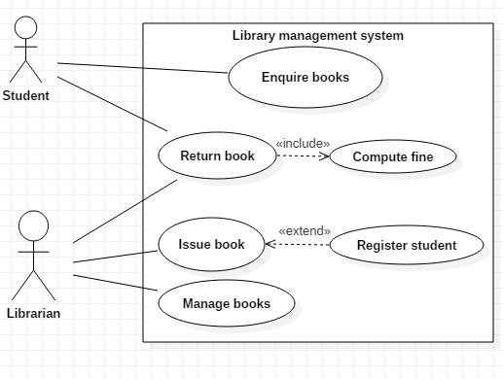
Library Management System

Slide 22
Hospital Management System
The system helps in registering information about patients. A unique ID is generated for each patient after registration. System helps in two types of registration process depending upon severity: Hospital admission or OPD appointment. Patient notes his/her appointment time and number from the receptionist and accordingly visits the doctor. This system also deals with testing appointments as and when ID is generated. The patient receives the appointment time and number and accordingly undergoes the test. It also deals with bed allotments to various patients by checking their ID.

Slide 23
Hospital Management System
The system administrator is responsible for handling various other activities like deleting, editing employee information into the database. The doctor diagnoses the patient, gives treatment and gives suggestions to patients and prescribe laboratory tests and medicines. The system generates patient’s discharge summary which includes patients health at the time of discharge, medical history, various diagnosis and drug prescriptions, history of patients illness and course in hospital. Patient can pay bill through credit card, cash or cheque whose information is maintained by this system.

Slide 24
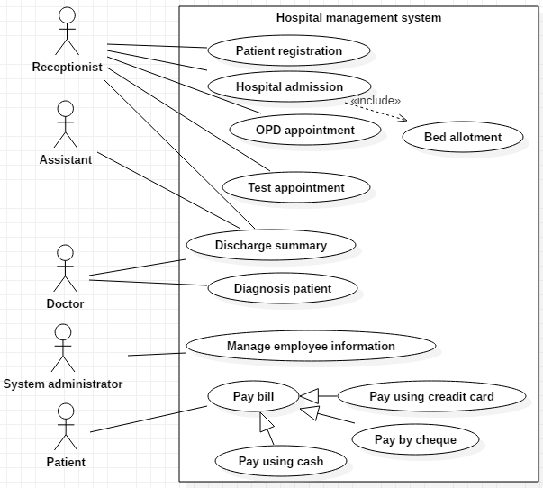

Slide 25
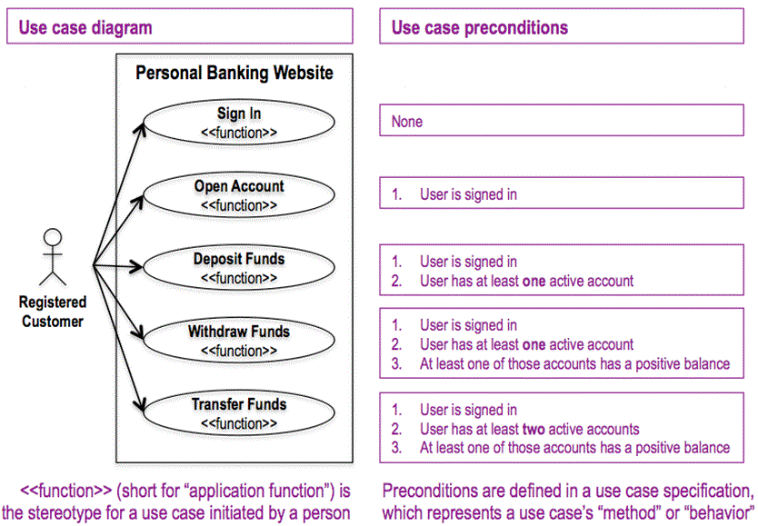
Precondition

Slide 26
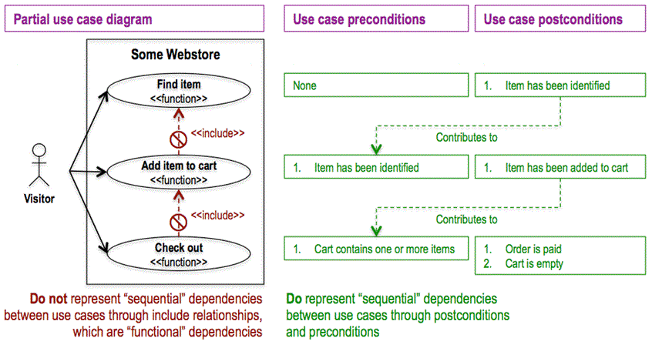
Preconditions and postconditions

Slide 27
Example- Cash Withdraw
Use Case: Withdraw Money
Author: SKA
Purpose: To withdraw cash from user’s bank account
Overview: The use case starts when the customer inserts his card into the system. The system requests the user’s PIN and validates it. If the validation succeeded, the customer can select the withdraw operation else validation failure is executed. The customer enters the amount of cash to withdraw. The system checks the amount of cash in the user account and ATM dispense limit. If the withdraw amount is less than the current balance and within ATM dispense limit, the system dispense the cash and prints a withdraw receipt. Otherwise “amount exceeded” is executed.

Slide 28
Example- Cash Withdraw
Actors: Customer
Pre Condition:
  The ATM must be in a state ready to accept transactions.
  The ATM must have at least some cash on hand that it can dispense.
  The ATM must have enough paper to print a receipt for at least one transaction.
Post Condition:
  The current balance in the user account is the amount before the withdraw minus the withdraw amount.
  A receipt printed the withdraw amount.
  The withdraw transaction written in the System log file.

Slide 29
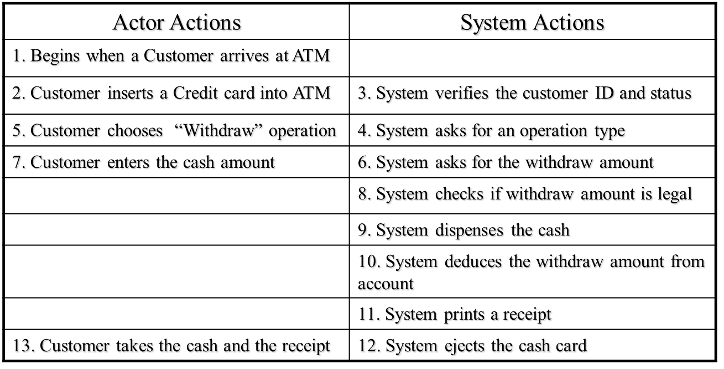
Typical course of events

Slide 30
Example- Cash Withdraw
Exceptional Flow
  Step 3: Customer authorization failed. Display an error message, cancel the transaction and eject the card.
  Step 8: Customer has insufficient funds in its account. Display an error message, and go to step 6.
  Step 8: Customer exceeds ATM dispense limit. Display an error message, and go to step 6.
  Power failure in the process of the transaction before step 9, cancel the transaction and eject the card.

Slide 31
Hotel Management System
A hotel may serve food to various clients at the same time. The food menu and food prepared by chef and waiter provide it to clients for ordering food. While ordering food, a client may also order wine. The waiter serves the food and serve wine also, if ordered. The client eat food and drink wine, if ordered. After eating the food, the client pay for food and for wine, if ordered, to waiter and waiter gives that amount to cashier. The cashier compute remaining cash and gives it to waiter. The waiter gives it to client. Draw a Use case diagram with labels on relationships.

Slide 32
